Slide 1
Image Steganography Using
LSB and DCT algorithm
Project by:
K Sreekar reddy (19bce1227)
P Saiteja (19bce1211)
Bollineni nishanth (19bce1805)

Slide 2
ABSTRACT
In the past, humans have used a lot of techniques like using invisible ink to conceal or hide information so that only particular people can extract the information present in the paper.
During the Revolutionary War invisible ink usually consisted of a mixture of ferrous sulfate and water. The secret writing was placed between the lines of an innocent letter and could be discerned by treating the letter with heat or a chemical substance.
As the technology developed hiding techniques also developed in these modern days which use digital images to hide confidential information.

Slide 3
Introduction
This paper introduces an algorithm of digital watermarking based on Least Significant Bit (LSB), Discrete Cosine Transform (DCT) and also image steganography (hiding image in an image) using Least Significant Bit Substitution technique.
According to the characters of human vision, in this algorithm, the information of digital watermarking which has been discrete Cosine transformed. Then distills the digital watermarking with the help of the original image and the watermarking image. The simulation results show that this algorithm is invisible and has good robustness for some common image processing operations.

Slide 4
Algorithms Used:
LSB (Least significant Bit) algorithm
Spatial Domain
DCT algorithm:
Frequency domain

Slide 5
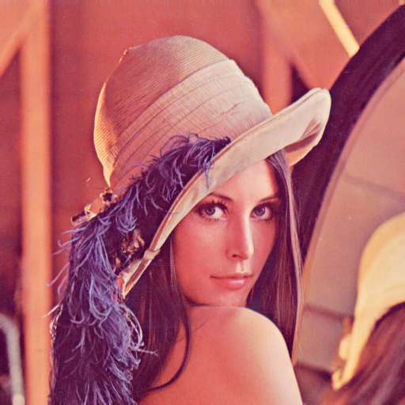
Input image

Slide 6


Encoded Image
LSB encoded image
DCT encoded image

Slide 7
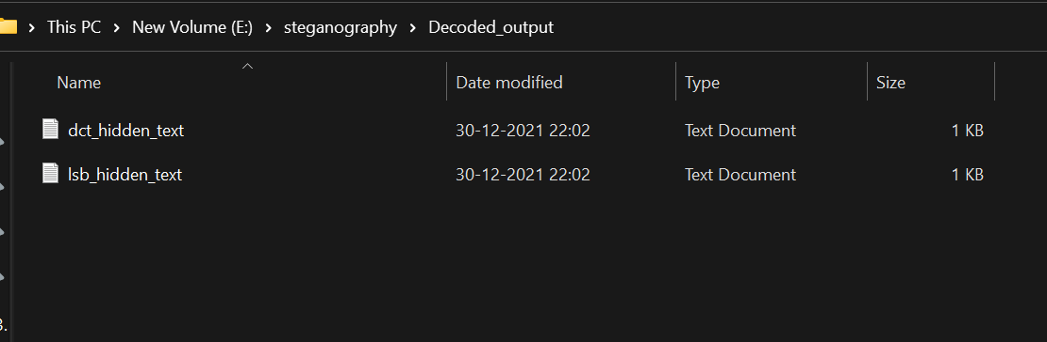
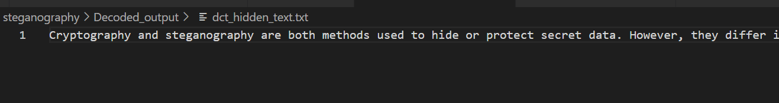
Decoded Output

Slide 8
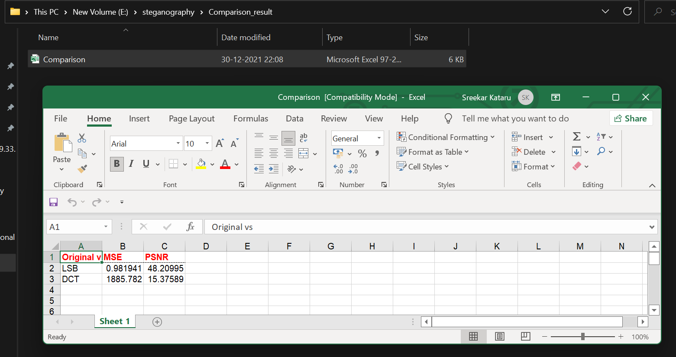
Comparison between 2 Algorithms

Slide 9

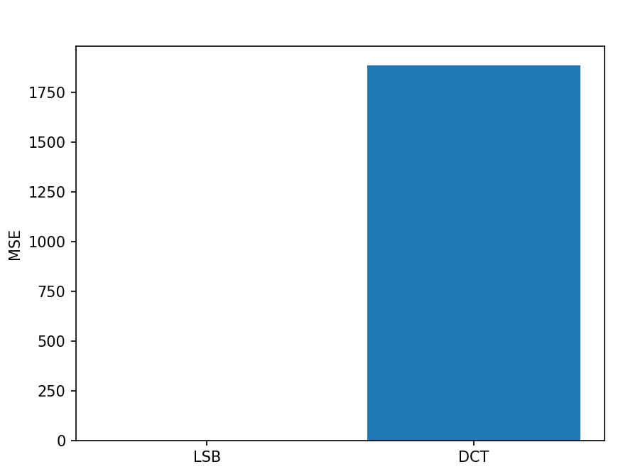
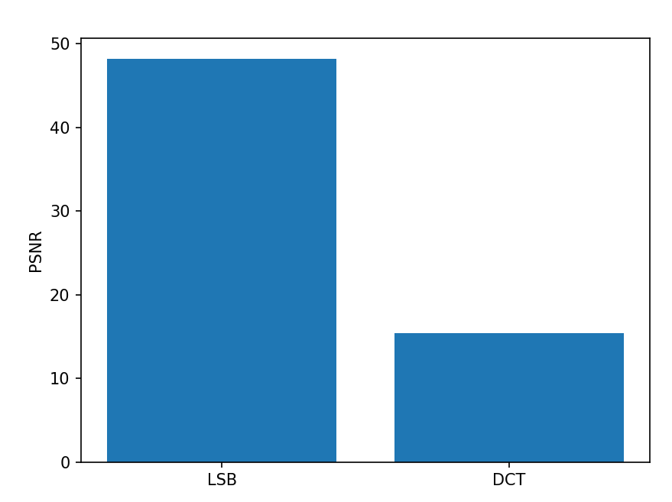
Comparison between 2 Algorithms

Slide 10
RESEARCH PAPERS REFERRED
https://jivp-eurasipjournals.springeropen.com/articles/10.1186/s13640-020-00534-2
https://www.researchgate.net/publication/335228119_An_Image_Steganography_Algorithm_using_LSB_Replacement_through_XOR_Substitution
https://www.researchgate.net/publication/330565811_Hiding_data_in_images_using_DCT_steganography_techniques_with_compression_algorithms
https://www.researchgate.net/publication/224074162_Analysis_of_LSB_based_image_steganography_techniques

Slide 11
THANK YOU

